Slide 1


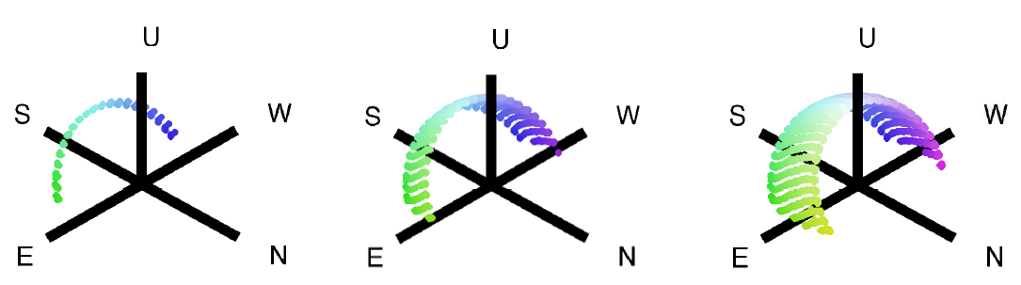
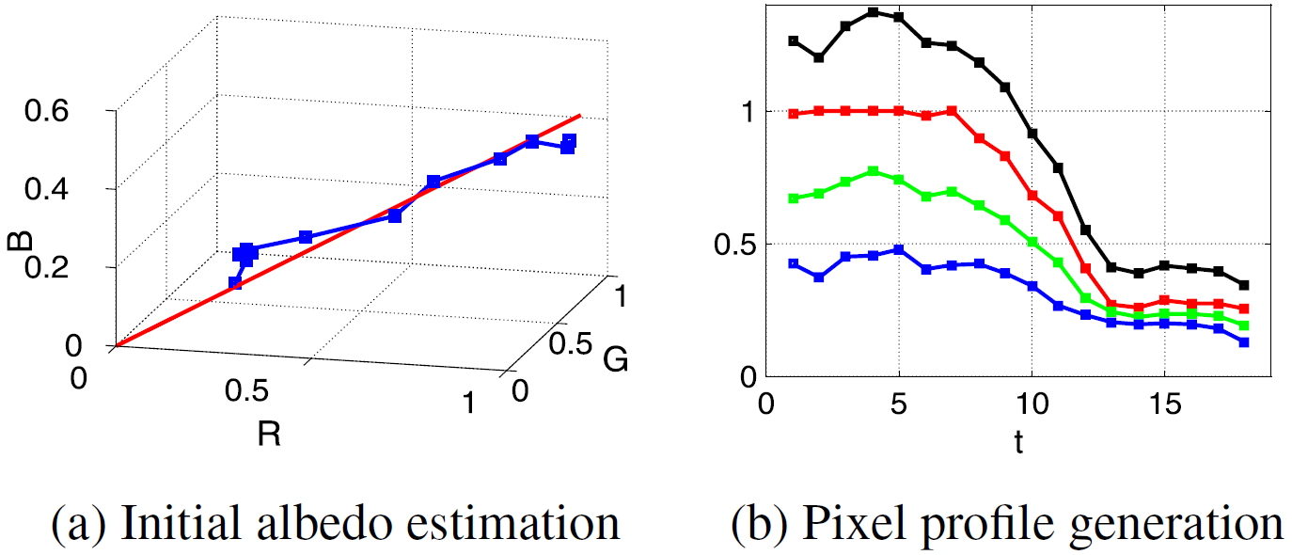
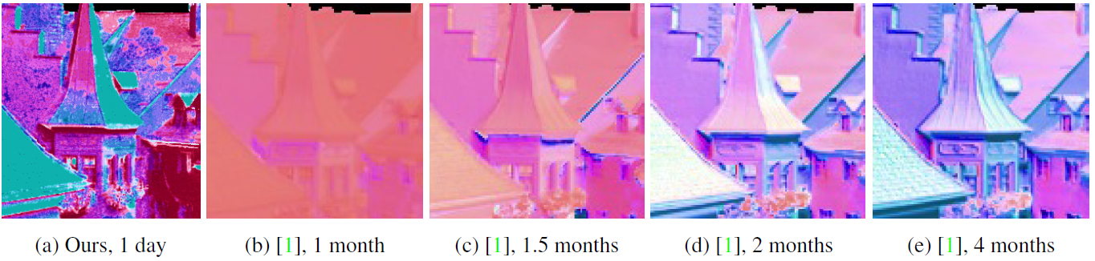
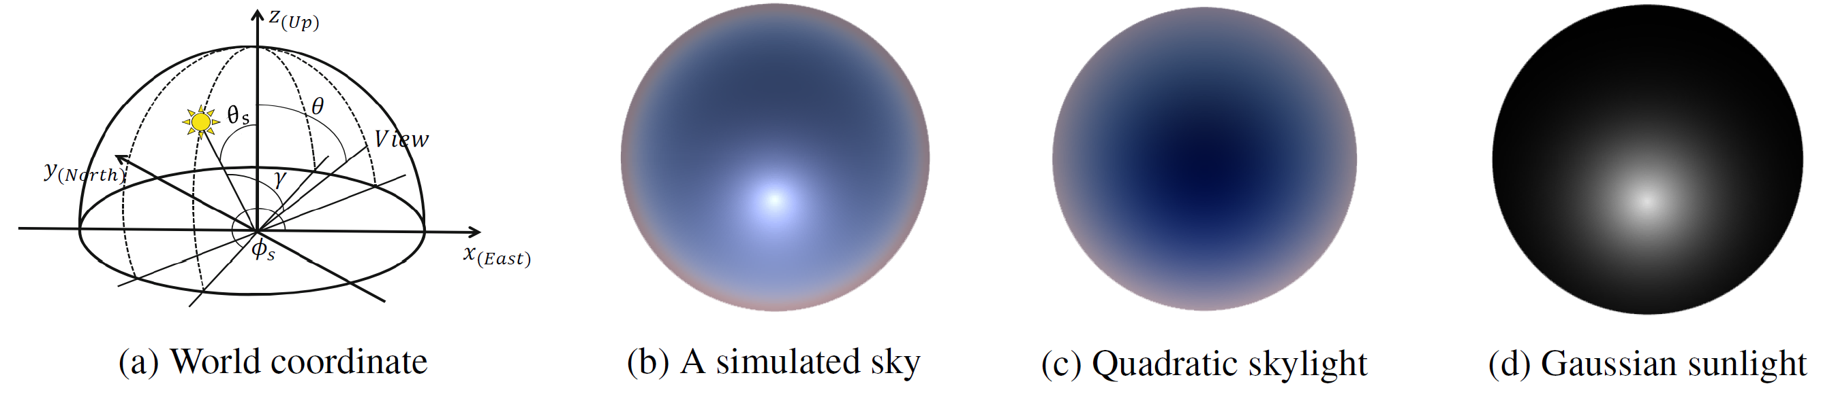
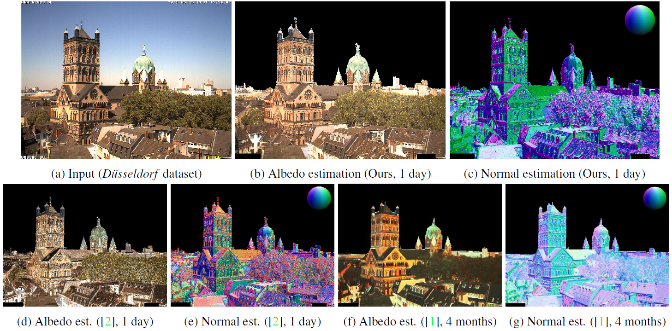
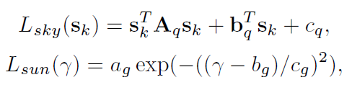
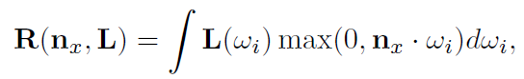
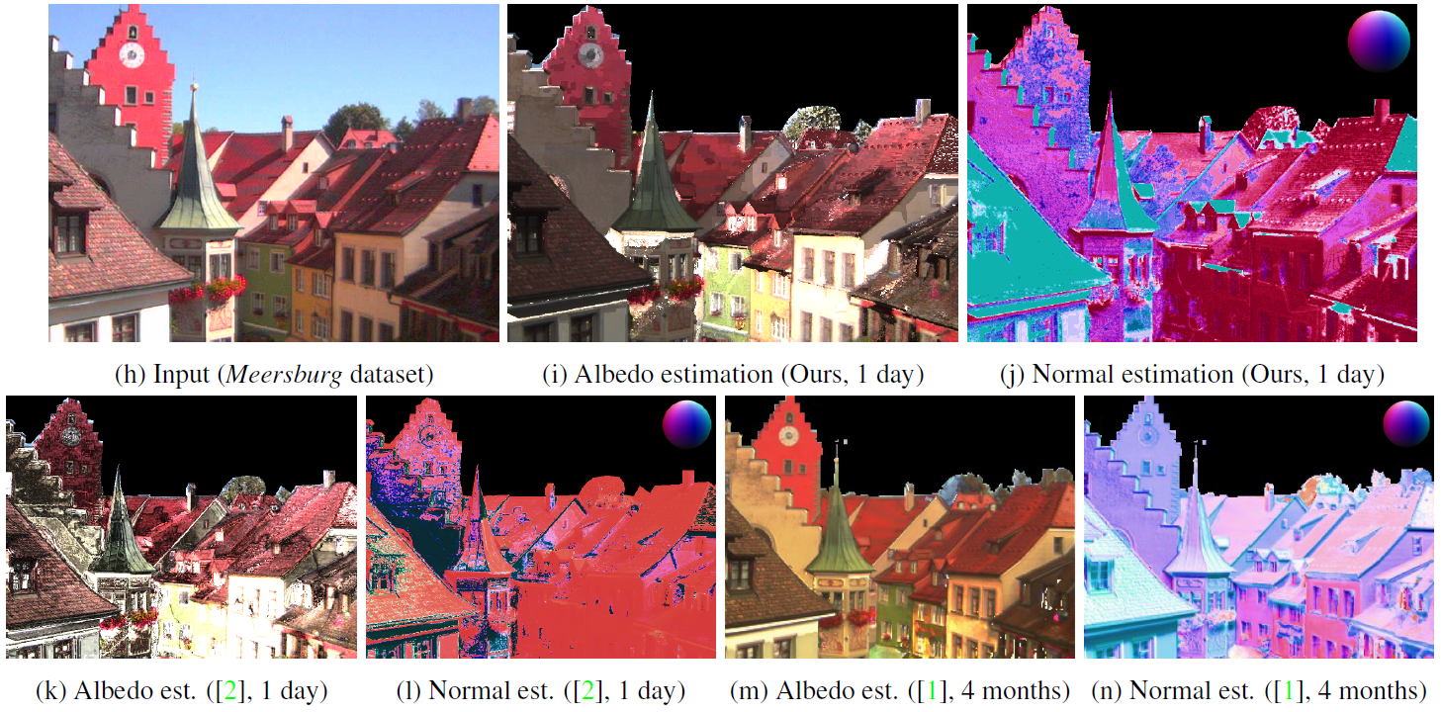
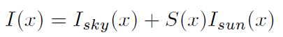
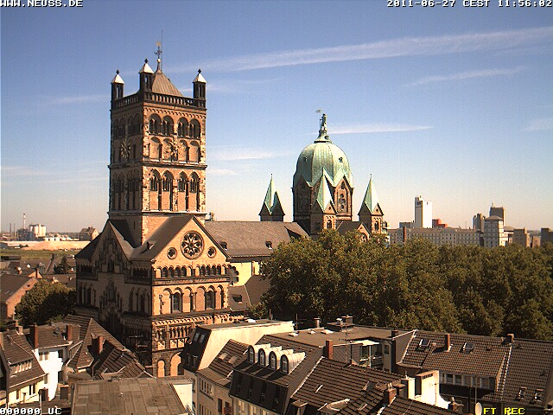
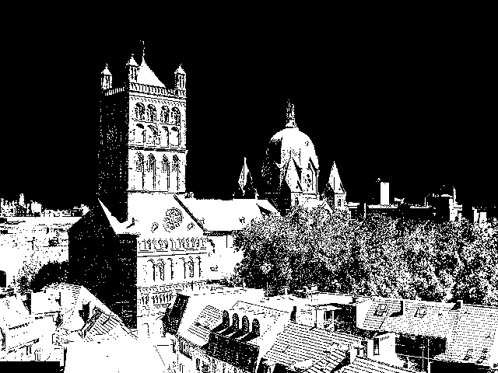
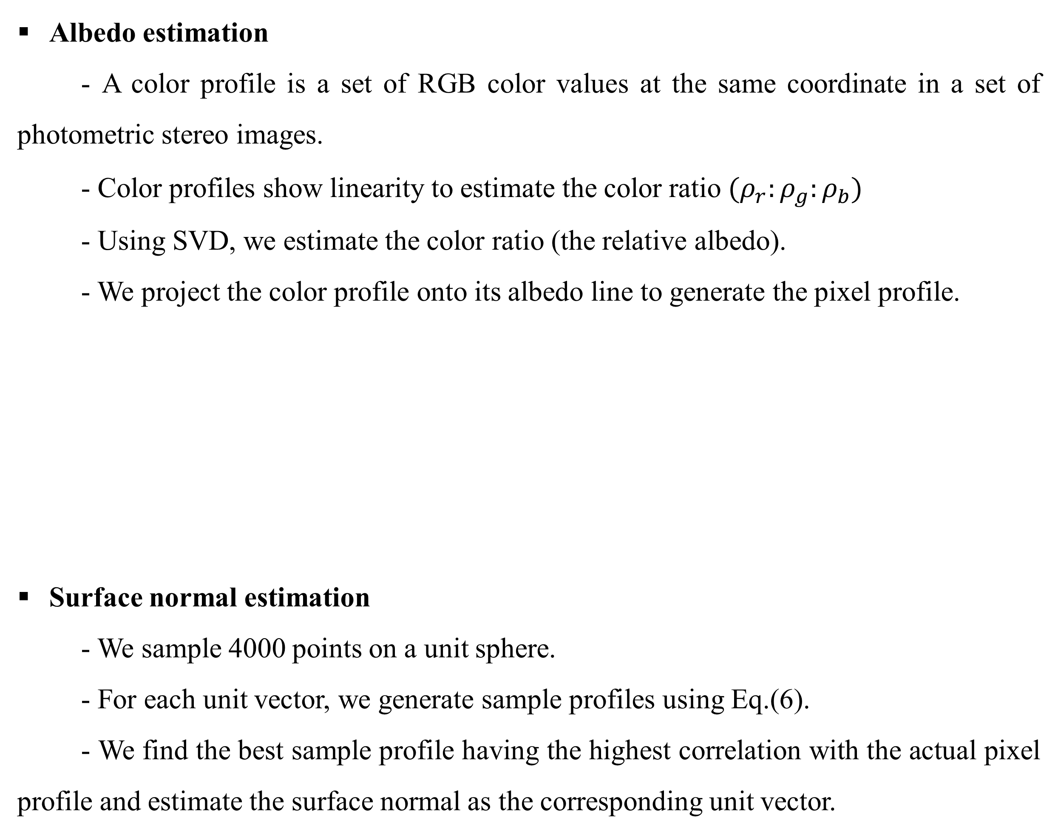
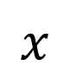
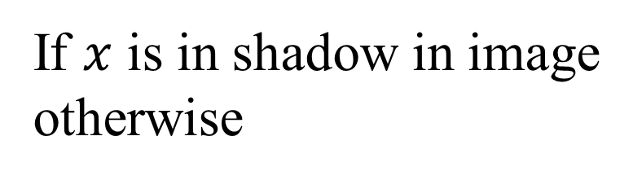
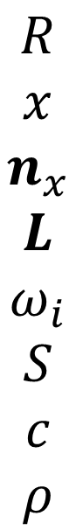
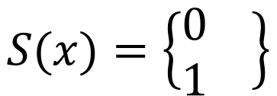
하늘빛 분포 추정을 이용한 야외 광도 스테레오
Jiyoung Jung, Joon-Young Lee, and In So Kweon Robotics and Computer Vision Laboratory, KAIST (http://rcv.kaist.ac.kr)
Introduction
Surface normal and albedo estimation
Traditional photometric stereo
- Three or more input images under different point light sources.
- The direction of the lights should not be coplanar.
- When the direction of the lights are known, the surface normal can be recovered.
Previous outdoor photometric stereo methods
- Lighting model: a point light (the sun) plus a constant ambient light
- Requires many months of images to deal with coplanarity of the light directions.
System configuration
- Input: geo-tagged, time-stamped images captured from a static camera in a day
- Output: surface normal of the scene (and albedo)
- Assumption: Lambertian scenes, image intensities are linear to scene irradiance
Albedo estimation
- A color profile is a set of RGB color values at the same coordinate in a set of photometric stereo images.
- Color profiles show linearity to estimate the color ratio $(ρ_{r}:ρ_{g}:ρ_{b})$
- Using SVD, we estimate the color ratio (the relative albedo).
- We project the color profile onto its albedo line to generate the pixel profile.
Surface normal estimation
- We sample 4000 points on a unit sphere.
- For each unit vector, we generate sample profiles using Eq.(6).
- We find the best sample profile having the highest correlation with the actual pixel profile and estimate the surface normal as the corresponding unit vector.
Figure from [1]. Input solar lighting directions during 1 month, 3 months, and 6 months.
Sky appearance and modeling
Experimental results
Perez sky model [4] and Preetham’s approximation [5]
θ and γ are determined by the time and location of the image capture.
Relative luminance l becomes a linear function of a single parameter, the turbidity, T.
Skylight parameterization
: a quadratic skylight distribution (c)
: a Gaussian sunlight distribution (d)
…(1)
…(2)
…(3)
Image formation
Assuming a linear camera, the irradiance is computed as the reflectance radiance by integrating the incident irradiance modulated by the reflectance over the illumination
…(4)
$$R$$
$$x$$
$$n_{x}$$
$$L$$
$$ω_{i}$$
$$S$$
$$c$$
$$ρ$$
: Reflectance
: A pixel location
: Surface normal at
: Illumination (light direction)
: Incident angle of the light
: Shadow estimation
: A color channel
: Albedo
…(5)
$$x$$
…(6)
$$S(x)=\left\{\begin{matrix}0 \\ 1\end{matrix} \right\}$$
If $x$ is in shadow in image
otherwise
We use shadow estimation method for [2]
Conclusion
References
We present an outdoor photometric stereo method based on the motivation that outdoor light condition can be generally modeled.
We adapt the skylight distribution [5] to work for outdoor photometric stereo without any depth priors of the scene.
We overcome the weak rank-3 qualification of sunlight directions during a single day by exploiting natural illumination via skylight estimation.
[1] A. Abrams, C. Hawley, and R. Pless, “Heliometric stereo: shape from sun position,” ECCV 2012.
[2] A. Abrams, K. Miskell, and R. Pless, “The episolar constraint: Monocular shape from shadow correspondence,” CVPR 2013.
[4] R. Perez, R. Seals, and J. Michalsky, “All-weather model for sky luminance distribution-preliminary configuration and validation,” Comm. Of ACM, vol. 50, no. 3, pp. 235-245, 1993.
[5] A. J. Preetham, P. Shirley, and B. Smits, “A practical analytic model for daylight,” ACM SIGGRAPH,1999.
[6] Archive of many outdoor scenes (AMOS). http://amos.cse.wustl.edu/

